Slide 1
Production Model Update Schedule

Slide 2
Example Calendar Showing Key Dates

Slide 3
TWO Updates of the Production Model per Month
1st Update – Before 2nd Tuesday
2nd Update – Before Last Tuesday

Slide 4
1st Update
To be completed before the 2nd Tuesday of Every Month

Slide 5
Step 1 Load Actuals From Prior Month
Mine Engineer Loads Actuals into Production Model

Slide 6
An Example of An EOM Production Report That Contains the Actual Information per Section Needed For the Production Model

Slide 7
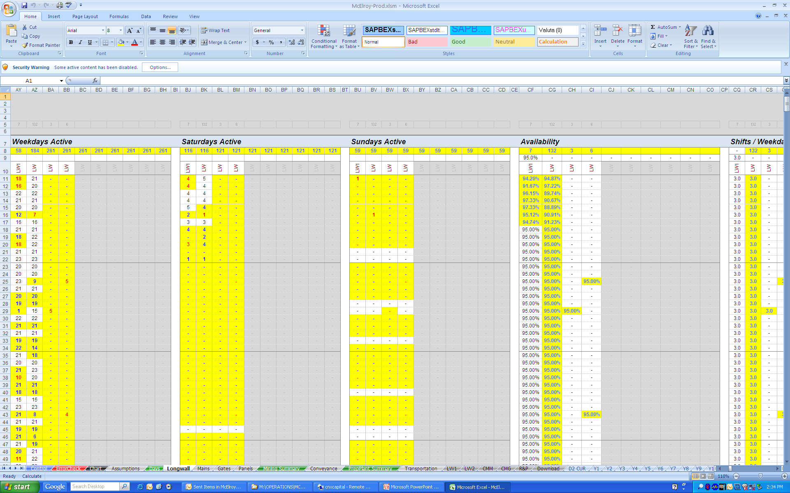
Enter Actuals From EOM Into Production Model
Monthly Assumptions Are Overwritten by Actuals From the End of the Month Production Report
4 Tabs to Enter Assumptions

Slide 8
Step 2 Update End of Month Face Locations in Forecaster
IF THE MINE ENGINEER IS USING THE FORECASTER PROGRAM PLEASE COMPLETE THIS STEP BEFORE REVIEWING THE PRODUCTION MODEL D2 REPORT
The Mine Engineer Runs the Most Recent mdb Forecaster File With the Updated End of the Month Face Locations and Then Links the mdb File to the Production Model.

Slide 9
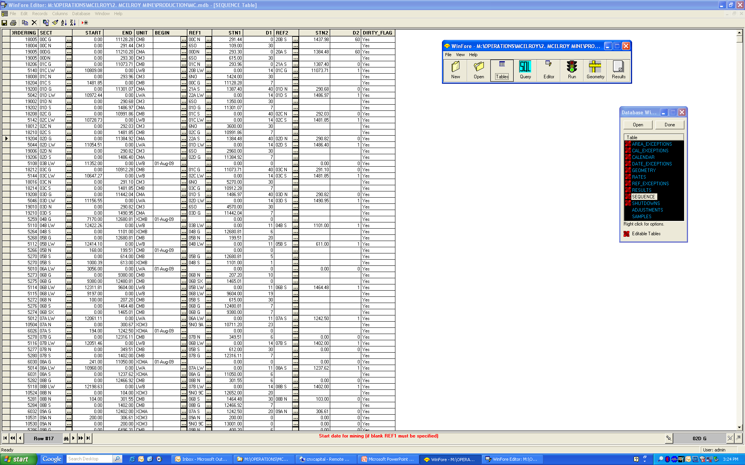
Update End of Month Face Locations in Forecaster
Update the Date for Each Active Section
Update the Section Plus for Each Active Section

Slide 10
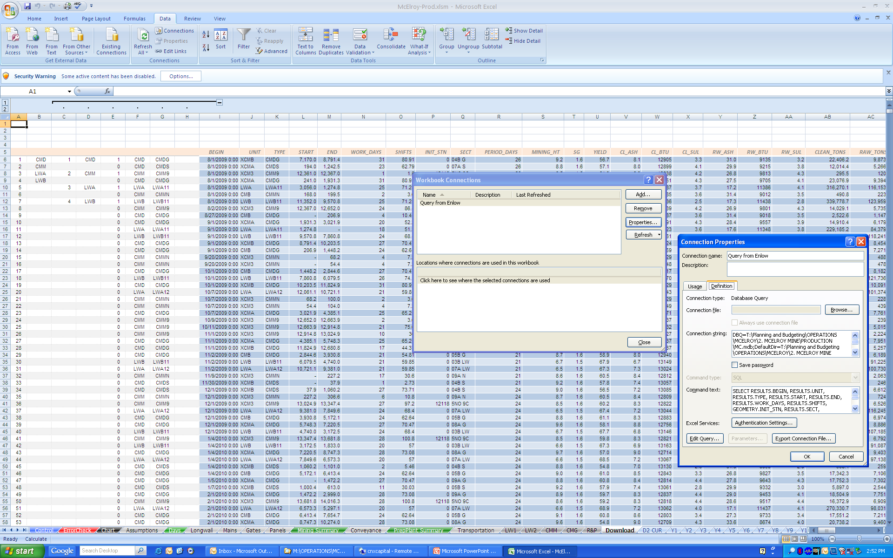
Link Forecaster Database to Production Model
1. Select Data
2. Select Connections
3. Select Properties
4. Insert the Path to the mdb File in 4 Locations
Database Linked to Download Tab

Slide 11
Step 3 Review Assumptions and Verify D2 Output is Correct
2 Options Possible
The Mine Engineer Reviews the Production Model Assumptions and D2 Sheets to Verify the Assumptions and Determines the Assumptions Should Remain the Same Going Forward.
The Review Reveals a Change to the Assumptions is Necessary.

Slide 12
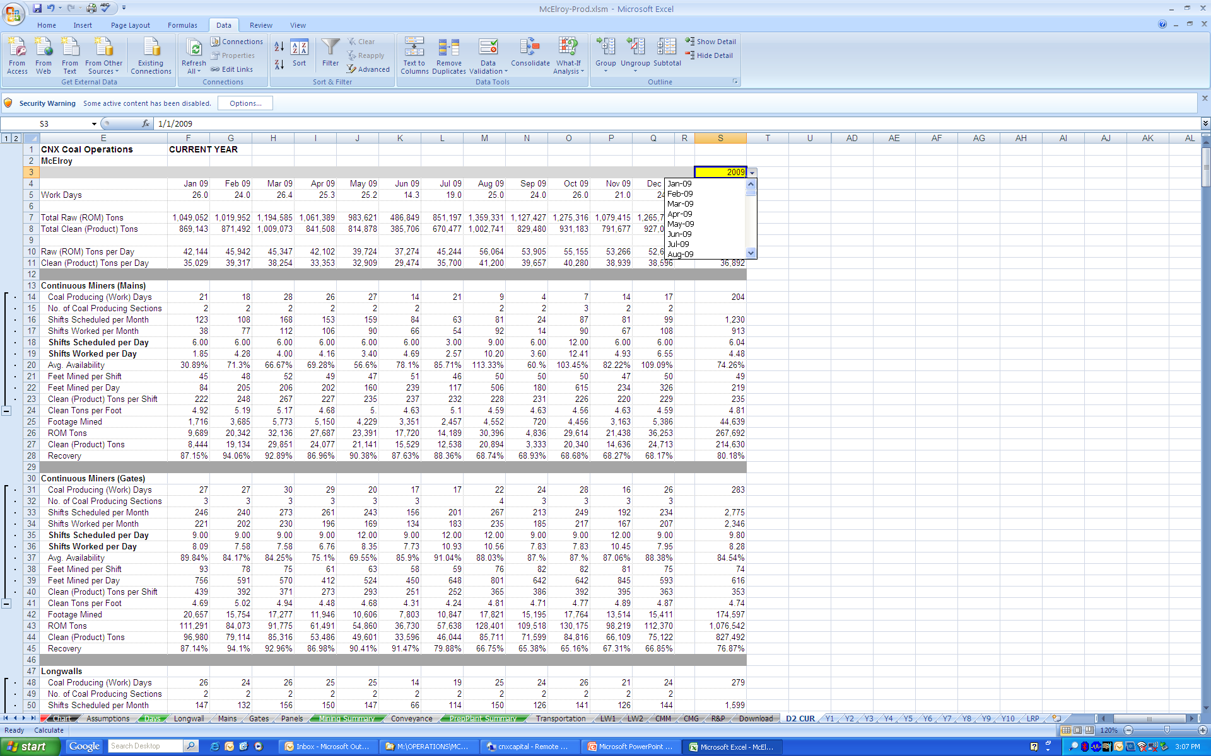
Review D2 Output From Production Model
Select Yellow Cell to Pick Month to Start Each Tab of D2 Report
Information Is Pulled From the Mining Summary Tab and Can be Printed to Review
After Review, Adjustments Can be Made to Assumptions Either in the Forecaster if Used or on the Longwall, Mains, Gates, or Panels Tabs. The Updates Move Through to the D2 Report
11 D2 Report Tabs

Slide 13
Option 1) Review Checks Out and Everything is Acceptable
After Verifying the Acceptability of the Production Model D2 Output With the Superintendent and/or VP:
Go to Step 4 – to Submit Update

Slide 14
Option 2) Review Reveals a Change to the Assumptions is Necessary
The Mine Engineer Should:
Discuss the Findings of the Review With the Superintendent.
Determine, with the Superintendent, How to Adjust the Assumptions to Better Forecast What is Occurring.
Then The Mine Engineer Should:
Make Adjustments to the Assumptions.
Take a Look at the New Output.
Inform the Superintendent and/or VP of the Changes Made and Differences Resulting From Those Changes in the D2 Output.

Slide 15
Step 4 Submit The 1st Update
After Verifying the Acceptability of the Production Model D2 Output With the Superintendent and/or VP:
The Mine Engineer Should Copy the Reviewed File and Any Linked Updated Forecaster mdb File and Quality mdb File to the Assigned Folder on the P Drive.
After Copying the Mine Engineer Should Send an Email Notification to Capital Planning Before the 2nd Tuesday of Every Month.

Slide 16
2nd Update
To be completed before the Last Tuesday of Every Month

Slide 17
Step 5 Update Face Locations in Forecaster
IF THE MINE ENGINEER IS USING THE FORECASTER PROGRAM PLEASE COMPLETE THIS STEP BEFORE REVIEWING THE PRODUCTION MODEL D2 REPORT
The Mine Engineer Runs the Most Recent mdb Forecaster File With Updated Face Locations as of Monday 12:01AM (Monday the day Before the Last Tuesday of the Month) and Then Links the mdb File to the Production Model.

Slide 18
Step 6 Review Assumptions and Verify D2 Output is Correct
2 Options Possible
The Mine Engineer Reviews the Production Model Assumptions and D2 Sheets to Verify the Assumptions and Determines the Assumptions Should Remain the Same Going Forward.
The Review Reveals a Change to the Assumptions is Necessary.

Slide 19
Review D2 Output From Production Model
Select Yellow Cell to Pick Month to Start Each Tab of D2 Report
Information Is Pulled From the Mining Summary Tab and Can be Printed to Review
After Review, Adjustments Can be Made to Assumptions Either in the Forecaster if Used or on the Longwall, Mains, Gates, or Panels Tabs. The Updates Move Through to the D2 Report
11 D2 Report Tabs

Slide 20
Option 1) Review Checks Out and Everything is Acceptable
After Verifying the Acceptability of the Production Model D2 Output With the Superintendent and/or VP:
Go to Step 7 – to Submit Update

Slide 21
Option 2) Review Reveals a Change to the Assumptions is Necessary
The Mine Engineer Should:
Discuss the Findings of the Review With the Superintendent.
Determine, with the Superintendent, How to Adjust the Assumptions to Better Forecast What is Occurring.
Then The Mine Engineer Should:
Make Adjustments to the Assumptions.
Take a Look at the New Output.
Inform the Superintendent and/or VP of the Changes Made and Differences Resulting From Those Changes in the D2 Output.

Slide 22
Step 7 Submit The 2nd Update
After Verifying the Acceptability of the Production Model D2 Output With the Superintendent and/or VP:
The Mine Engineer Should Copy the Reviewed File and Any Linked Updated Forecaster mdb File and Quality mdb File to the Assigned Folder on the P Drive.
After Copying the Mine Engineer Should Send an Email Notification to Capital Planning Before the Last Tuesday of Every Month.

